Slide 1
Warm-up as you walk in
For the following Bayes net, write the query P(X₄ | e_{1:4}) in terms of the conditional probability tables associated with the Bayes net.
P(X₄ | e₁,e₂,e₃,e₄) =
X₁
X₂
X₃
X₄
e₁
e₂
e₃
e₄

Slide 2
Announcements
Assignments
HW11
Due Thur 4/25
P5
Due Thur, 5/2
In-class Polls
Denominator capped after midterm 2, 56 polls

Slide 3

AI: Representation and Problem Solving
HMMs and Particle Filters
Instructors: Pat Virtue & Stephanie Rosenthal
Slide credits: CMU AI and http://ai.berkeley.edu

Slide 4
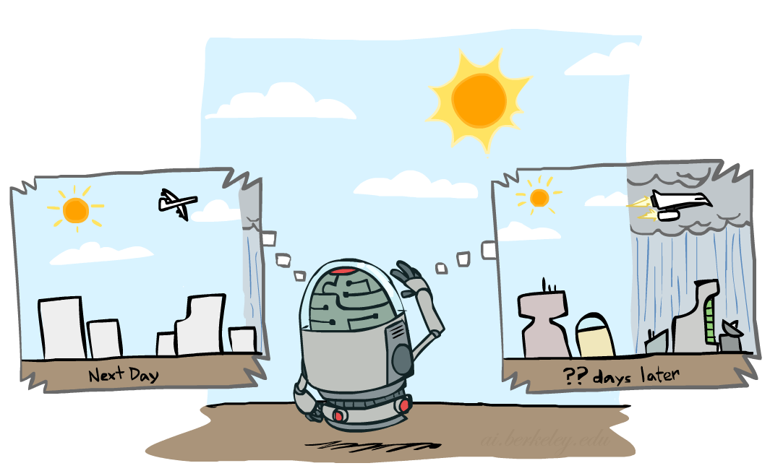
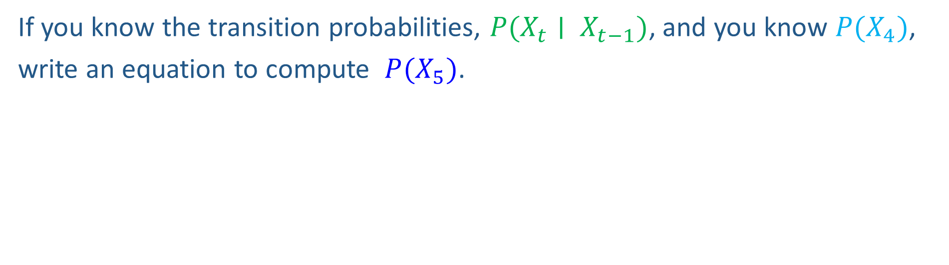
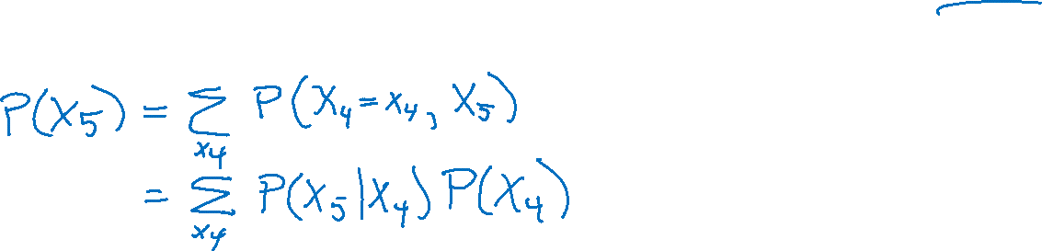
Markov chain warm-up
X₁
X₂
X₃
X₄
If you know the transition probabilities, $P(X_{t}∣ X_{t−1})$, and you know $P(X_{4})$,
write an equation to compute $P(X_{5})$.

Slide 5
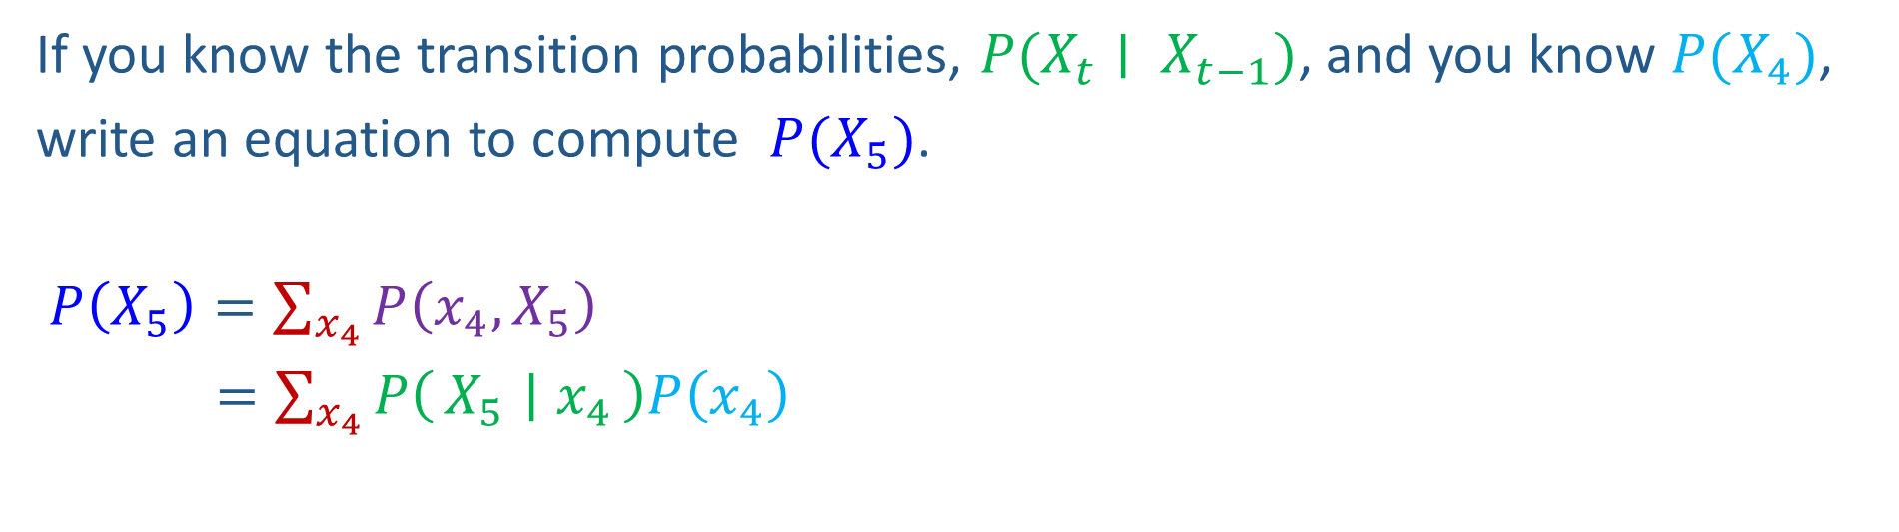
Markov chain warm-up
X₁
X₂
X₃
X₄
If you know the transition probabilities, $P(X_{t}∣ X_{t−1})$, and you know $P(X_{4})$,
write an equation to compute $P(X_{5})$.
$P\left(X_{5}\right)=\sum_{x_{4}}{P\left(x_{4},X_{5}\right)}$
$=\sum_{x_{4}}{P\left(X_{5} ∣ x_{4}\right)P\left(x_{4}\right)}$

Slide 6
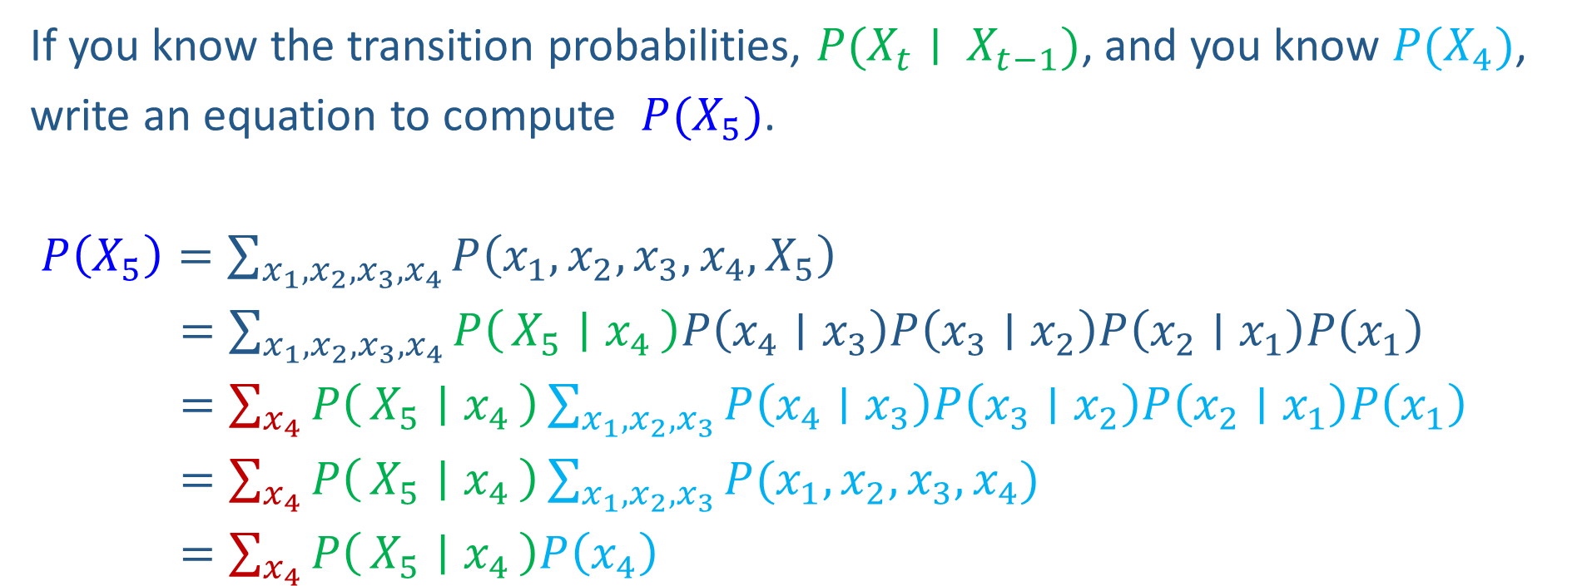
Markov chain warm-up
X₁
X₂
X₃
X₄
If you know the transition probabilities, $P(X_{t}∣ X_{t−1})$, and you know $P(X_{4})$,
write an equation to compute $P(X_{5})$.
$P\left(X_{5}\right)=\sum_{{x_{1},x_{2}, x_{3},x}_{4}}{P\left({x_{1},x_{2},x_{3},x}_{4},X_{5}\right)}$
$=\sum_{{x_{1},x_{2}, x_{3},x}_{4}}{P\left(X_{5} ∣ x_{4}\right)P\left(x_{4}∣x_{3}\right)P\left(x_{3}∣x_{2}\right)P\left(x_{2}∣x_{1}\right)P\left(x_{1}\right)}$
$=\sum_{x_{4}}{P\left(X_{5} ∣ x_{4}\right)}\sum_{x_{1},x_{2}, x_{3}}{P\left(x_{4}∣x_{3}\right)P\left(x_{3}∣x_{2}\right)P\left(x_{2}∣x_{1}\right)P\left(x_{1}\right)}$
$=\sum_{x_{4}}{P\left(X_{5} ∣ x_{4}\right)}\sum_{x_{1},x_{2}, x_{3}}{P(x_{1},x_{2},x_{3},x_{4})}$
$=\sum_{x_{4}}{P\left(X_{5} ∣ x_{4}\right)P\left(x_{4}\right)}$

Slide 7
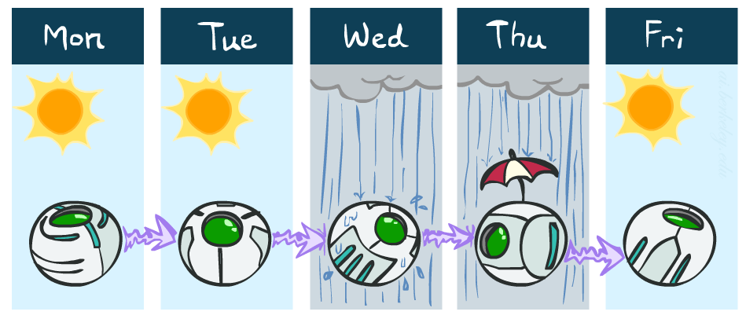
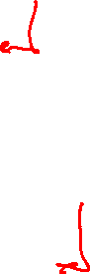
Weather prediction
States {rain, sun}
Initial distribution P(X₀)
Transition model P(X_{t} | X_{t-1})
P(X₀)
sun | rain
0.5 | 0.5
Two new ways of representing the same CPT
0.9
0.3
0.9
X_{t-1} | P(X_{t}|X_{t-1})
 | sun | rain
sun | 0.9 | 0.1
rain | 0.3 | 0.7
rain
sun
sun
sun
0.1
0.3
rain
rain
0.7
0.7
0.1

Slide 8
Weather prediction
X_{t-1} | P(X_{t}|X_{t-1})
 | sun | rain
sun | 0.9 | 0.1
rain | 0.3 | 0.7
Time 0: P(X₀) =<0.5,0.5>
What is the weather like at time 1?
P(X₁) =
∑_{x0} P(X₀=x_{0,} X₁)
= ∑_{x0} P(X₁| X₀=x₀) P(X₀=x₀)
= 0.5<0.9,0.1> + 0.5<0.3,0.7>
= <0.6,0.4>
X₀
X₁

Slide 9
Weather prediction, contd.
X_{t-1} | P(X_{t}|X_{t-1})
 | sun | rain
sun | 0.9 | 0.1
rain | 0.3 | 0.7
Time 1: P(X₁) =<0.6,0.4>
What is the weather like at time 2?
P(X₂) =
∑_{x1} P(X₁=x₁, X₂)
= ∑_{x1} P(X₂| X₁=x₁) P(X₁=x₁)
= 0.6<0.9,0.1> + 0.4<0.3,0.7>
= <0.66,0.34>
X₀
X₁
X₂

Slide 10
Weather prediction, contd.
X_{t-1} | P(X_{t}|X_{t-1})
 | sun | rain
sun | 0.9 | 0.1
rain | 0.3 | 0.7
Time 2: P(X₂) =<0.66,0.34>
What is the weather like at time 3?
P(X₃) =
∑_{x2} P(X₂=x₂, X₃)
= ∑_{x2} P(X₃| X₂=x₂) P(X₂=x₂)
= 0.66<0.9,0.1> + 0.34<0.3,0.7>
= <0.696,0.304>
X₁
X₂
X₃

Slide 11
Forward algorithm (simple form)
Probability from previous iteration
What is the state at time t?
P(X_{t}) = ∑_{xt-1} P(X_{t-1}=x_{t-1}, X_{t})
= ∑_{xt-1} P(X_{t}| X_{t-1}=x_{t-1}) P(X_{t-1}=x_{t-1})
Iterate this update starting at t=0
Transition model

Slide 12

Hidden Markov Models

Slide 13
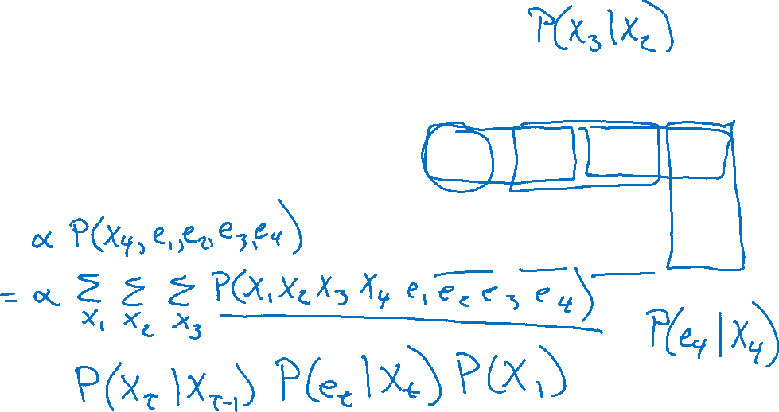

HMM as a Bayes Net Warm-up
For the following Bayes net, write the query P(X₄ | e_{1:4}) in terms of the conditional probability tables associated with the Bayes net.
P(X₄ | e₁,e₂,e₃,e₄) =
X₁
X₂
X₃
X₄
e₁
e₂
e₃
e₄

Slide 14
Hidden Markov Models
Usually the true state is not observed directly
Hidden Markov models (HMMs)
Underlying Markov chain over states X
You observe evidence E at each time step
X_{t} is a single discrete variable; E_{t} may be continuous and may consist of several variables
X₀
X₁
X₂
X₃
X₅
E₁
E₂
E₃
E₅

Slide 15


Example: Weather HMM
An HMM is defined by:
Initial distribution: P(X₀)
Transition model: P(X_{t} | X_{t-1})
Sensor model: P(E_{t} | X_{t})
W_{t-1} | P(W_{t}|W_{t-1})
 | sun | rain
sun | 0.9 | 0.1
rain | 0.3 | 0.7
Weather _{t-1}
Weather _{t}
Weather _{t+1}
W_{t} | P(U_{t}|W_{t})
 | true | false
sun | 0.2 | 0.8
rain | 0.9 | 0.1
Umbrella _{t-1}
Umbrella _{t}
Umbrella _{t+1}
Notes:
demo

Slide 16


Example: Ghostbusters HMM
State: location of moving ghost
Observations: Color recorded by ghost sensor at clicked squares
P(X₀) = uniform
P(X_{t} | X_{t-1}) = usually move clockwise, but sometimes move randomly or stay in place
P(C_{tij} | X_{t}) = same sensor model as before: red means close, green means far away.
1/6
1/6
1/2
0
1/6
0
0
0
0
1/9
1/9
1/9
1/9
1/9
1/9
P( X₂ | X₁=(2,3) )
1/9
1/9
1/9
P(X₁)
X₀
X₁
X₂
X₃
X₅
C_{1ij}
C_{2ij}
C_{3ij}
[Demo: Ghostbusters – Circular Dynamics – HMM (L14D2)]
Notes:
Dan has some demo for this.

Slide 17
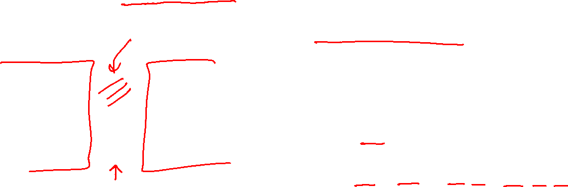
HMM as Probability Model
Joint distribution for Markov model:
P(X₀,…, X_{T}) = P(X₀) ∏_{t=1:T} P(X_{t} | X_{t-1})
Joint distribution for hidden Markov model:
P(X₀, X₁,E₁, …, X_{T},E_{T}) = P(X₀) ∏_{t=1:T} P(X_{t} | X_{t-1}) P(E_{t} | X_{t})
Future states are independent of the past given the present
Current evidence is independent of everything else given the current state
Are evidence variables independent of each other?
X₀
X₁
X₂
X₃
X₅
Useful notation: X_{a:b} = X_{a} , X_{a+1}, …, X_{b}
For example: P(X_{1:2} | e_{1:3}) = P(X₁, X₂, | e₁ , e₂, e₃)
E₁
E₂
E₃
E₅
Notes:
Add conditional independence consequences here

Slide 18
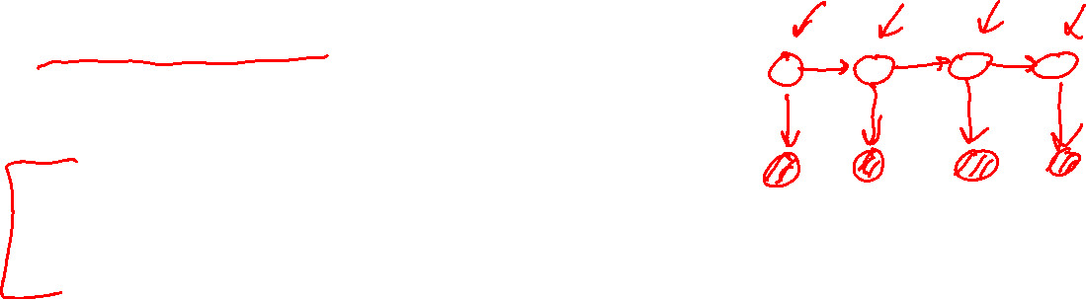
Real HMM Examples
Speech recognition HMMs:
Observations are acoustic signals (continuous valued)
States are specific positions in specific words (so, tens of thousands)
Machine translation HMMs:
Observations are words (tens of thousands)
States are translation options
Robot tracking:
Observations are range readings (continuous)
States are positions on a map (continuous)
Molecular biology:
Observations are nucleotides ACGT
States are coding/non-coding/start/stop/splice-site etc.

Slide 19
Other HMM Queries
Filtering: P(X_{t}|e_{1:t})
Prediction: P(X_{t+k}|e_{1:t})
X₁
X₂
X₃
X₄
X₁
X₂
X₃
X₄
e₁
e₂
e₃
e₄
e₁
e₂
e₃
Smoothing: P(X_{k}|e_{1:t}), k<t
Explanation: P(X_{1:t}|e_{1:t})
X₁
X₂
X₃
X₄
X₁
X₂
X₃
X₄
e₁
e₂
e₃
e₄
e₁
e₂
e₃
e₄

Slide 20

Inference Tasks
Filtering: P(X_{t}|e_{1:t})
belief state—input to the decision process of a rational agent
Prediction: P(X_{t+k}|e_{1:t}) for k > 0
evaluation of possible action sequences; like filtering without the evidence
Smoothing: P(X_{k}|e_{1:t}) for 0 ≤ k < t
better estimate of past states, essential for learning
Most likely explanation: argmax_{x1:t} P(x_{1:t} | e_{1:t})
speech recognition, decoding with a noisy channel

Slide 21
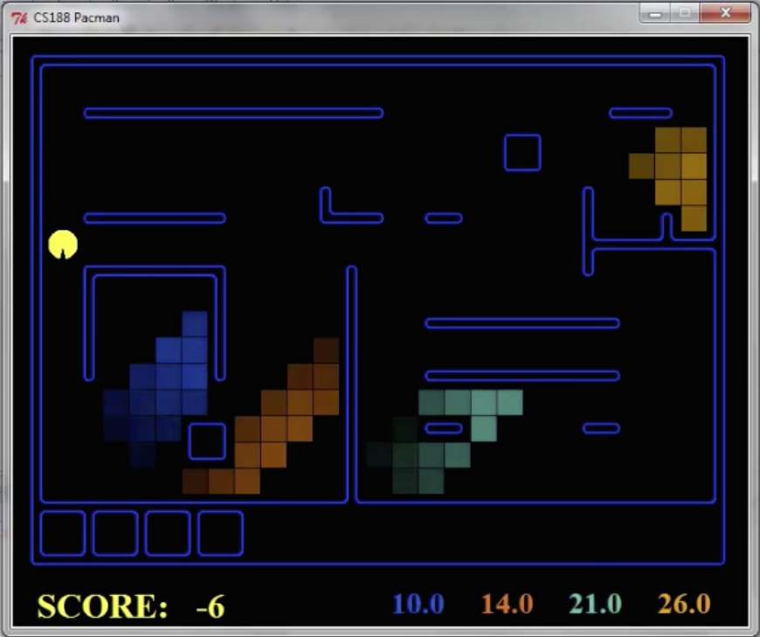
Pacman – Hunting Invisible Ghosts with Sonar
[Demo: Pacman – Sonar – No Beliefs(L14D1)]

Slide 22

Filtering Algorithm
P(X_{t+1}|e_{1:t+1}) = α P(e_{t+1}|X_{t+1}) ∑_{xt} P(X_{t+1}| x_{t}) P(x_{t} | e_{1:t})
f_{1:t+1} = Forward(f_{1:t} , e_{t+1})
Normalize
Update
Predict

Slide 23
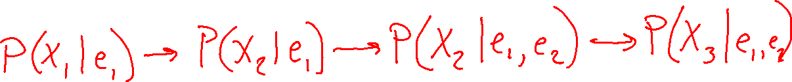
Filtering Algorithm
Query: What is the current state, given all of the current and past evidence?
Marching forward through the HMM network
X₁
X₂
e₁
e₂

Slide 24
Filtering Algorithm
Query: What is the current state, given all of the current and past evidence?
Marching forward through the HMM network
X₁
X₂
X₃
e₁
e₂
e₃

Slide 25
Filtering Algorithm
Query: What is the current state, given all of the current and past evidence?
Marching forward through the HMM network
X₁
X₂
X₃
X₄
e₁
e₂
e₃
e₄

Slide 26
Filtering Algorithm
Query: What is the current state, given all of the current and past evidence?
Marching forward through the HMM network
X₁
X₂
X₃
X₄
e₁
e₂
e₃
e₄

Slide 27

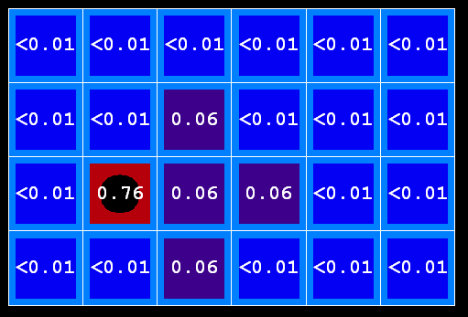
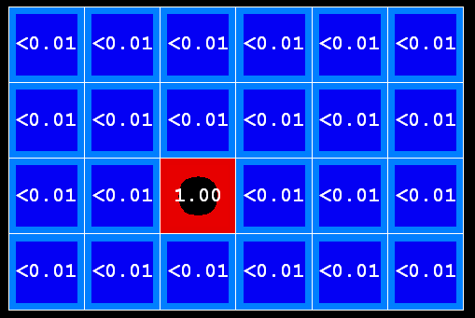
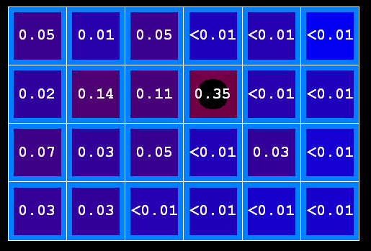
Example: Prediction step
As time passes, uncertainty “accumulates”
(Transition model: ghosts usually go clockwise)
T = 1
T = 2
T = 5

Slide 28


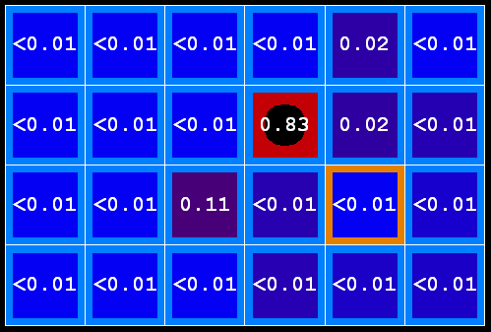
Example: Update step
As we get observations, beliefs get reweighted, uncertainty “decreases”
Before observation
After observation

Slide 29
Demo Ghostbusters – Circular Dynamics -- HMM

Slide 30
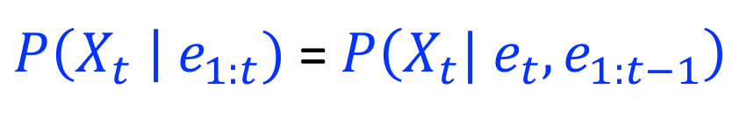

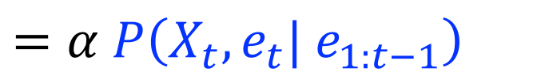
Filtering Algorithm
Query: What is the current state, given all of the current and past evidence?
Matching math with Bayes net
$P\left(X_{t} \right| e_{1:t})$ =$P\left(X_{t}{| e_{t}, e}_{1:t−1}\right)$
X₁
X₂
X₃
X₄
$$=α P\left(X_{t}, {e_{t}| e}_{1:t−1}\right)$$
e₁
e₂
e₃
e₄
Def. of cond. probability with $X_{t}$, $e_{t}$
Notes:
Explain propto

Slide 31
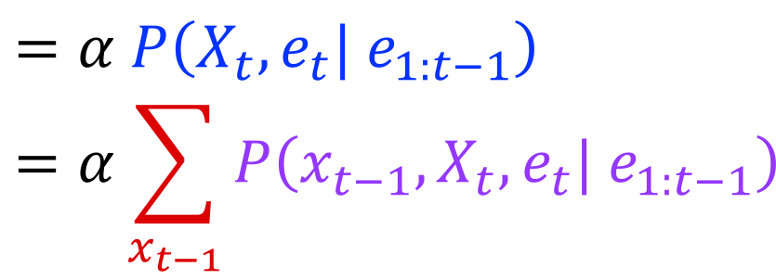
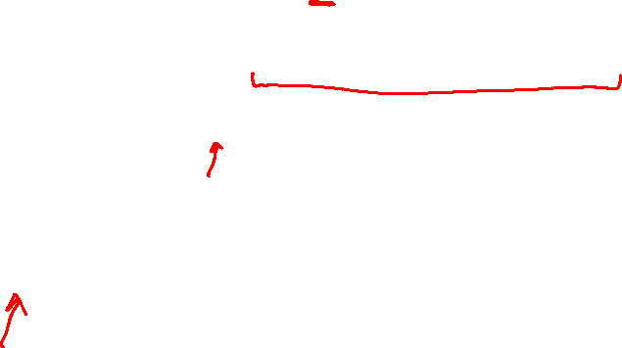

Filtering Algorithm
Query: What is the current state, given all of the current and past evidence?
Matching math with Bayes net
$P\left(X_{t} \right| e_{1:t})$ =$P\left(X_{t}{| e_{t}, e}_{1:t−1}\right)$
X₁
X₂
X₃
X₄
$$=α P\left(X_{t}, {e_{t}| e}_{1:t−1}\right)$$
$$=α\sum_{x_{t−1}}{P\left(x_{t−1},X_{t}, e_{t}| e_{1:t−1}\right)}$$
e₁
e₂
e₃
e₄
Summation over variable $X_{t−1}$

Slide 32
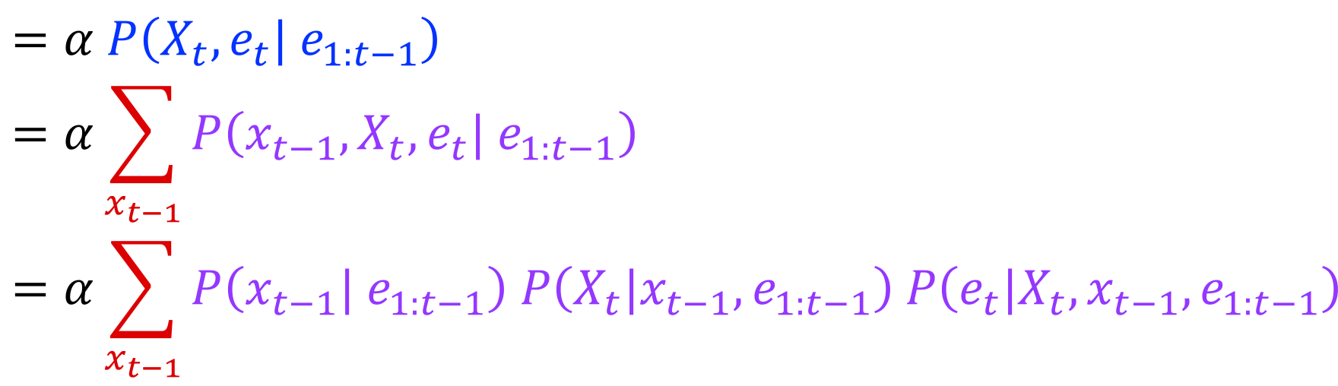

Filtering Algorithm
Query: What is the current state, given all of the current and past evidence?
Matching math with Bayes net
$P\left(X_{t} \right| e_{1:t})$ =$P\left(X_{t}{| e_{t}, e}_{1:t−1}\right)$
X₁
X₂
X₃
X₄
$$=α P\left(X_{t}, {e_{t}| e}_{1:t−1}\right)$$
$$=α\sum_{x_{t−1}}{P\left(x_{t−1},X_{t}, e_{t}| e_{1:t−1}\right)}$$
$$=α\sum_{x_{t−1}}{P\left(x_{t−1}| e_{1:t−1}\right) P\left(X_{t}|x_{t−1},e_{1:t−1}\right) P\left(e_{t}|X_{t},x_{t−1},e_{1:t−1}\right)}$$
e₁
e₂
e₃
e₄
Chain rule with $x_{t−1}$, $X_{t}$, and $e_{t}$

Slide 33
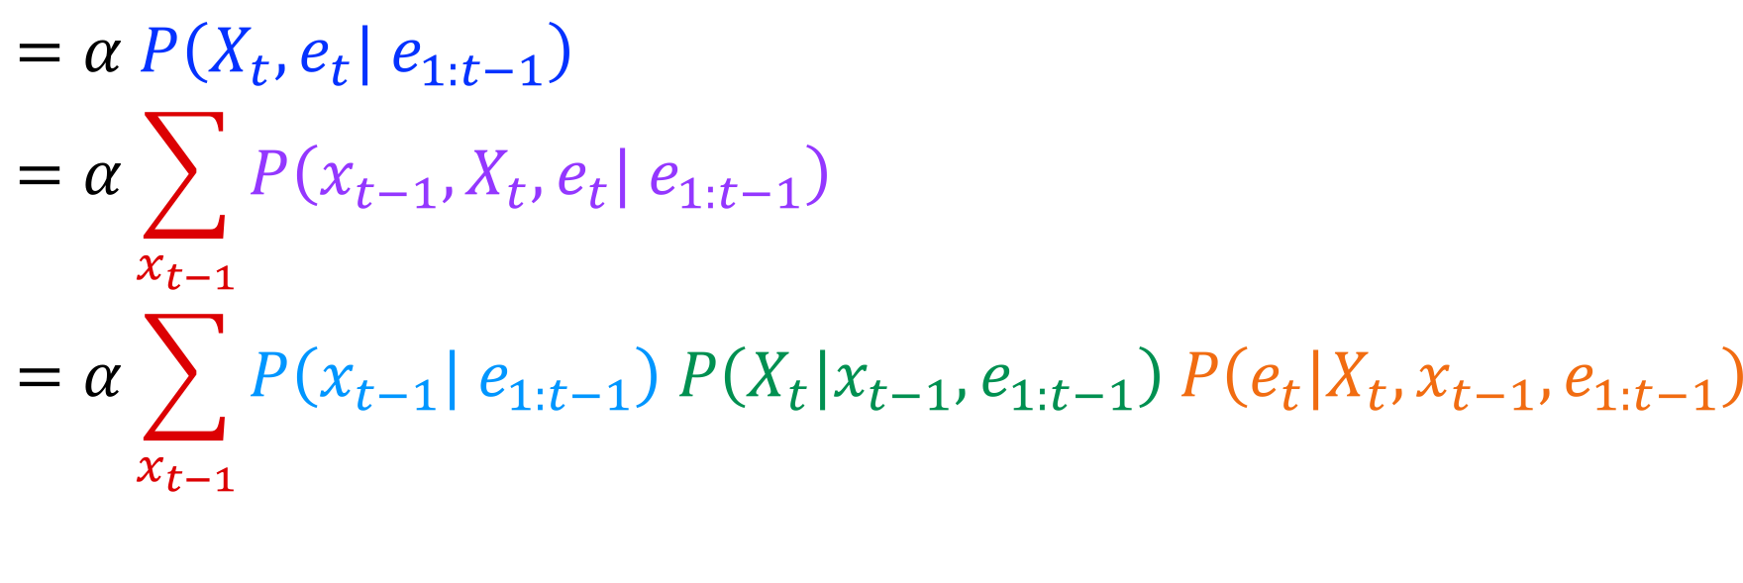
Filtering Algorithm
Query: What is the current state, given all of the current and past evidence?
Matching math with Bayes net
$P\left(X_{t} \right| e_{1:t})$ =$P\left(X_{t}{| e_{t}, e}_{1:t−1}\right)$
X₁
X₂
X₃
X₄
$$=α P\left(X_{t}, {e_{t}| e}_{1:t−1}\right)$$
$$=α\sum_{x_{t−1}}{P\left(x_{t−1},X_{t}, e_{t}| e_{1:t−1}\right)}$$
$$=α\sum_{x_{t−1}}{P\left(x_{t−1}| e_{1:t−1}\right) P\left(X_{t}|x_{t−1},e_{1:t−1}\right) P\left(e_{t}|X_{t},x_{t−1},e_{1:t−1}\right)}$$
e₁
e₂
e₃
e₄
Chain rule with $x_{t−1}$, $X_{t}$, and $e_{t}$

Slide 34
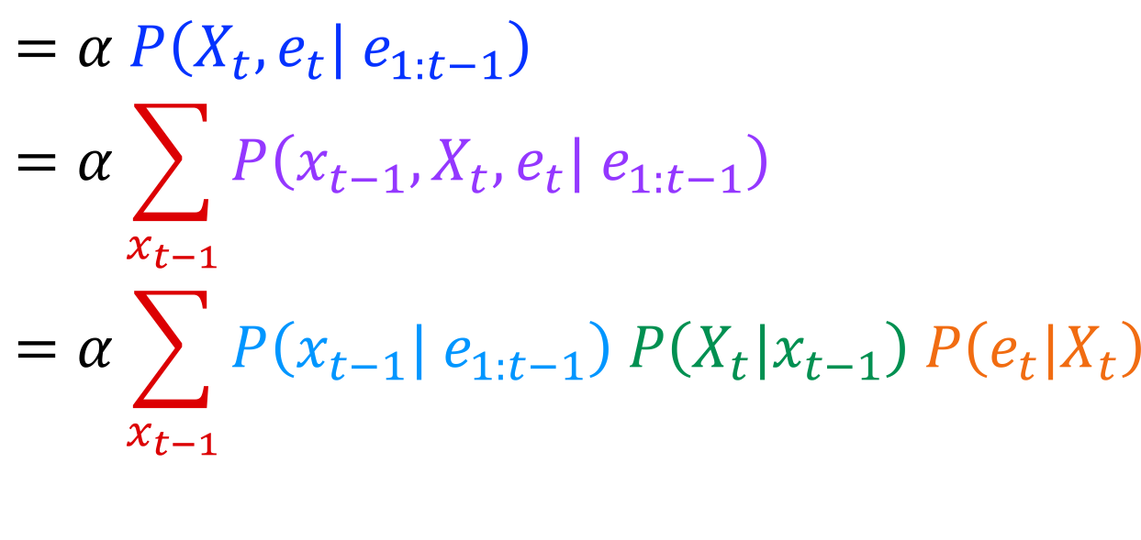
Filtering Algorithm
Query: What is the current state, given all of the current and past evidence?
Matching math with Bayes net
$P\left(X_{t} \right| e_{1:t})$ =$P\left(X_{t}{| e_{t}, e}_{1:t−1}\right)$
X₁
X₂
X₃
X₄
$$=α P\left(X_{t}, {e_{t}| e}_{1:t−1}\right)$$
$$=α\sum_{x_{t−1}}{P\left(x_{t−1},X_{t}, e_{t}| e_{1:t−1}\right)}$$
$$=α\sum_{x_{t−1}}{P\left(x_{t−1}| e_{1:t−1}\right) P\left(X_{t}|x_{t−1}\right) P\left(e_{t}|X_{t}\right)}$$
e₁
e₂
e₃
e₄
Bayes net conditional independence

Slide 35
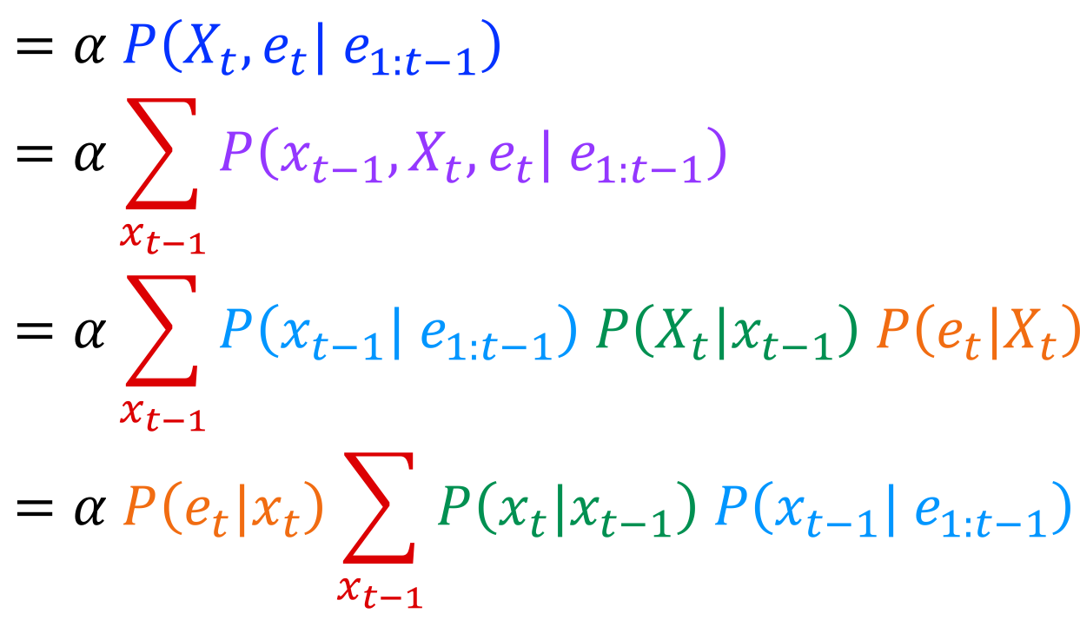


Filtering Algorithm
Query: What is the current state, given all of the current and past evidence?
Matching math with Bayes net
$P\left(X_{t} \right| e_{1:t})$ =$P\left(X_{t}{| e_{t}, e}_{1:t−1}\right)$
X₁
X₂
X₃
X₄
$$=α P\left(X_{t}, {e_{t}| e}_{1:t−1}\right)$$
$$=α\sum_{x_{t−1}}{P\left(x_{t−1},X_{t}, e_{t}| e_{1:t−1}\right)}$$
$$=α\sum_{x_{t−1}}{P\left(x_{t−1}| e_{1:t−1}\right) P\left(X_{t}|x_{t−1}\right) P\left(e_{t}|X_{t}\right)}$$
$$=α P\left(e_{t}|x_{t}\right)\sum_{x_{t−1}}{P\left(x_{t}|x_{t−1}\right) P\left(x_{t−1}| e_{1:t−1}\right) }$$
e₁
e₂
e₃
e₄
Pulling $P\left(e_{t}|X_{t}\right)$ out of the summation

Slide 36
Filtering Algorithm
Query: What is the current state, given all of the current and past evidence?
Matching math with Bayes net
$P\left(X_{t} \right| e_{1:t})$ =$P\left(X_{t}{| e_{t}, e}_{1:t−1}\right)$
X₁
X₂
X₃
X₄
$$=α P\left(X_{t}, {e_{t}| e}_{1:t−1}\right)$$
$$=α\sum_{x_{t−1}}{P\left(x_{t−1},X_{t}, e_{t}| e_{1:t−1}\right)}$$
$$=α\sum_{x_{t−1}}{P\left(x_{t−1}| e_{1:t−1}\right) P\left(X_{t}|x_{t−1}\right) P\left(e_{t}|X_{t}\right)}$$
$$=α P\left(e_{t}|x_{t}\right)\sum_{x_{t−1}}{P\left(x_{t}|x_{t−1}\right) P\left(x_{t−1}| e_{1:t−1}\right) }$$
e₁
e₂
e₃
e₄
Recursion!

Slide 37
Filtering Algorithm
Query: What is the current state, given all of the current and past evidence?
Matching math with Bayes net
$P\left(X_{t} \right| e_{1:t})$ =$P\left(X_{t}{| e_{t}, e}_{1:t−1}\right)$
X₁
X₂
X₃
X₄
$$=α P\left(X_{t}, {e_{t}| e}_{1:t−1}\right)$$
$$=α\sum_{x_{t−1}}{P\left(x_{t−1},X_{t}, e_{t}| e_{1:t−1}\right)}$$
$$=α\sum_{x_{t−1}}{P\left(x_{t−1}| e_{1:t−1}\right) P\left(X_{t}|x_{t−1}\right) P\left(e_{t}|X_{t}\right)}$$
$$=α P\left(e_{t}|x_{t}\right)\sum_{x_{t−1}}{P\left(x_{t}|x_{t−1}\right) P\left(x_{t−1}| e_{1:t−1}\right) }$$
e₁
e₂
e₃
e₄
Recursion!

Slide 38

Filtering Algorithm
P(X_{t+1}|e_{1:t+1}) = α P(e_{t+1}|X_{t+1}) ∑_{xt} P(X_{t+1}| x_{t}) P(x_{t} | e_{1:t})
f_{1:t+1} = Forward(f_{1:t} , e_{t+1})
Cost per time step: O(|X|²) where |X| is the number of states
Time and space costs are constant, independent of t
O(|X|²) is infeasible for models with many state variables
We get to invent really cool approximate filtering algorithms
Normalize
Update
Predict

Slide 39
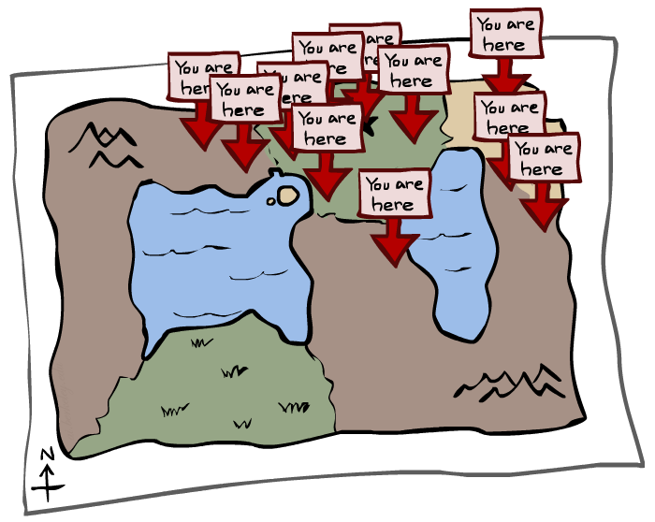
Particle Filtering

Slide 40
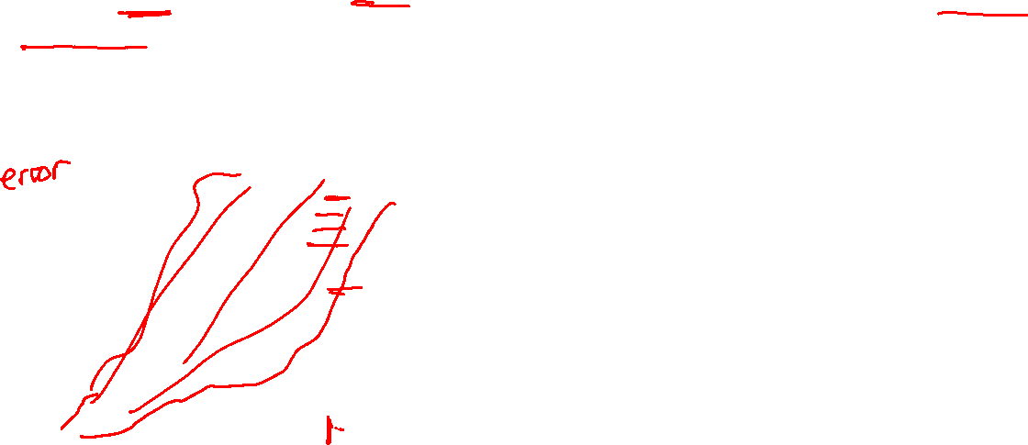
We need a new algorithm!
When |X| is more than 10⁶ or so (e.g., 3 ghosts in a 10x20 world), exact inference becomes infeasible
Likelihood weighting fails completely – number of samples needed grows exponentially with T
X₀
X₁
X₂
X₃
E₁
E₂
E₃

Slide 41
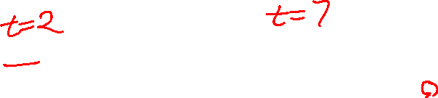
We need a new idea!
t=2
t=7
The problem: sample state trajectories go off into low-probability regions, ignoring the evidence; too few “reasonable” samples
Solution: kill the bad ones, make more of the good ones
This way the population of samples stays in the high-probability region
This is called resampling or survival of the fittest

Slide 42
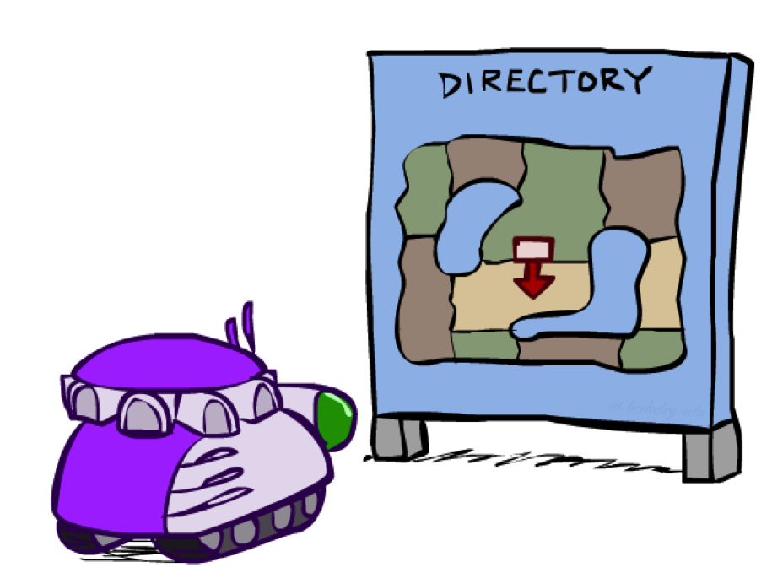
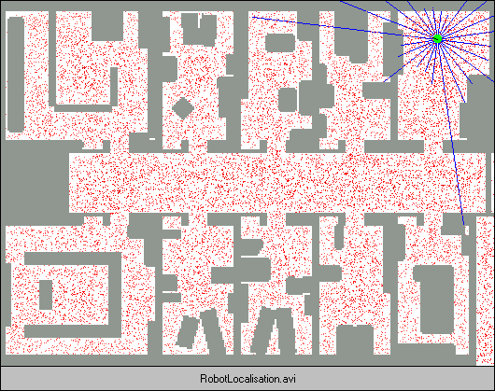
Robot Localization
In robot localization:
We know the map, but not the robot’s position
Observations may be vectors of range finder readings
State space and readings are typically continuous (works basically like a very fine grid) and so we cannot store B(X)
Particle filtering is a main technique

Slide 43

Particle Filter Localization (Sonar)
[Dieter Fox, et al.]
[Video: global-sonar-uw-annotated.avi]

Slide 44
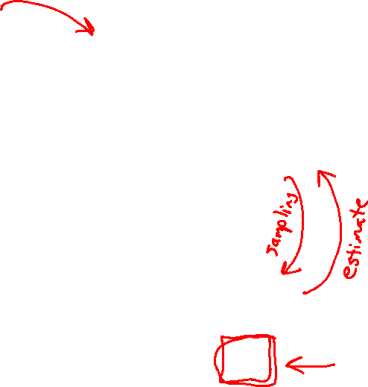
Particle Filtering
Represent belief state by a set of samples
Samples are called particles
Time per step is linear in the number of samples
But: number needed may be large
This is how robot localization works in practice
0.0
0.1
0.0
0.0
0.0
0.2
0.0
0.2
0.5

Slide 45

Representation: Particles
Our representation of P(X) is now a list of N particles (samples)
Generally, N << |X|
Storing map from X to counts would defeat the point
P(x) approximated by number of particles with value x
So, many x may have P(x) = 0!
More particles, more accuracy
Usually we want a low-dimensional marginal
E.g., “Where is ghost 1?” rather than “Are ghosts 1,2,3 in {2,6], [5,6], and [8,11]?”
For now, all particles have a weight of 1
Particles:
(3,3)
(2,3)
(3,3)
(3,2)
(3,3)
(3,2)
(1,2)
(3,3)
(3,3)
(2,3)

Slide 46
Particle Filtering: Propagate forward
A particle in state x_{t} is moved by sampling its next position directly from the transition model:
x_{t+1} ~ P(X_{t+1} | x_{t})
Here, most samples move clockwise, but some move in another direction or stay in place
This captures the passage of time
If enough samples, close to exact values before and after (consistent)
Particles:
(3,3)
(2,3)
(3,3)
(3,2)
(3,3)
(3,2)
(1,2)
(3,3)
(3,3)
(2,3)
Particles:
(3,2)
(2,3)
(3,2)
(3,1)
(3,3)
(3,2)
(1,3)
(2,3)
(3,2)
(2,2)

Slide 47
Particle Filtering: Observe
Particles:
(3,2)
(2,3)
(3,2)
(3,1)
(3,3)
(3,2)
(1,3)
(2,3)
(3,2)
(2,2)
Slightly trickier:
Don’t sample observation, fix it
Similar to likelihood weighting, weight samples based on the evidence
W = P(e_{t}| x_{t})
Normalize the weights: particles that fit the data better get higher weights, others get lower weights
Particles:
(3,2) w=.9
(2,3) w=.2
(3,2) w=.9
(3,1) w=.4
(3,3) w=.4
(3,2) w=.9
(1,3) w=.1
(2,3) w=.2
(3,2) w=.9
(2,2) w=.4

Slide 48
Particle Filtering: Resample
Rather than tracking weighted samples, we resample
N times, we choose from our weighted sample distribution (i.e., draw with replacement)
Now the update is complete for this time step, continue with the next one
Particles:
(3,2) w=.9
(2,3) w=.2
(3,2) w=.9
(3,1) w=.4
(3,3) w=.4
(3,2) w=.9
(1,3) w=.1
(2,3) w=.2
(3,2) w=.9
(2,2) w=.4
(New) Particles:
(3,2)
(2,2)
(3,2)
(2,3)
(3,3)
(3,2)
(1,3)
(2,3)
(3,2)
(3,2)

Slide 49
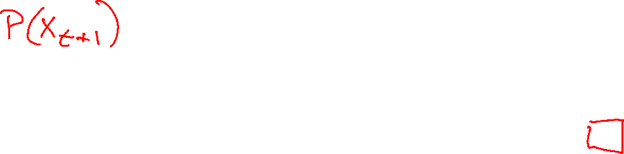
Summary: Particle Filtering
Particles: track samples of states rather than an explicit distribution
Propagate forward
Weight
Resample
Particles:
(3,3)
(2,3)
(3,3)
(3,2)
(3,3)
(3,2)
(1,2)
(3,3)
(3,3)
(2,3)
Particles:
(3,2)
(2,3)
(3,2)
(3,1)
(3,3)
(3,2)
(1,3)
(2,3)
(3,2)
(2,2)
Particles:
(3,2) w=.9
(2,3) w=.2
(3,2) w=.9
(3,1) w=.4
(3,3) w=.4
(3,2) w=.9
(1,3) w=.1
(2,3) w=.2
(3,2) w=.9
(2,2) w=.4
(New) Particles:
(3,2)
(2,2)
(3,2)
(2,3)
(3,3)
(3,2)
(1,3)
(2,3)
(3,2)
(3,2)
Consistency: see proof in AIMA Ch. 15
[Demos: ghostbusters particle filtering (L15D3,4,5)]

Slide 50
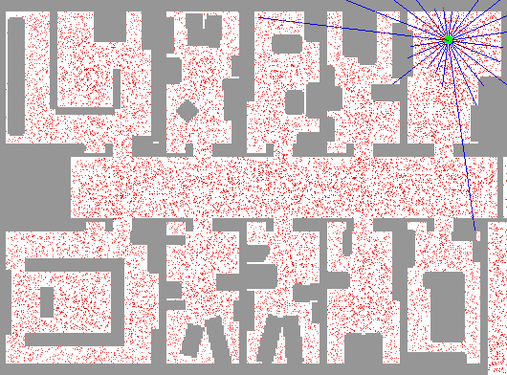
Particle Filter Localization (Laser)
[Dieter Fox, et al.]
[Video: global-floor.gif]

Slide 51

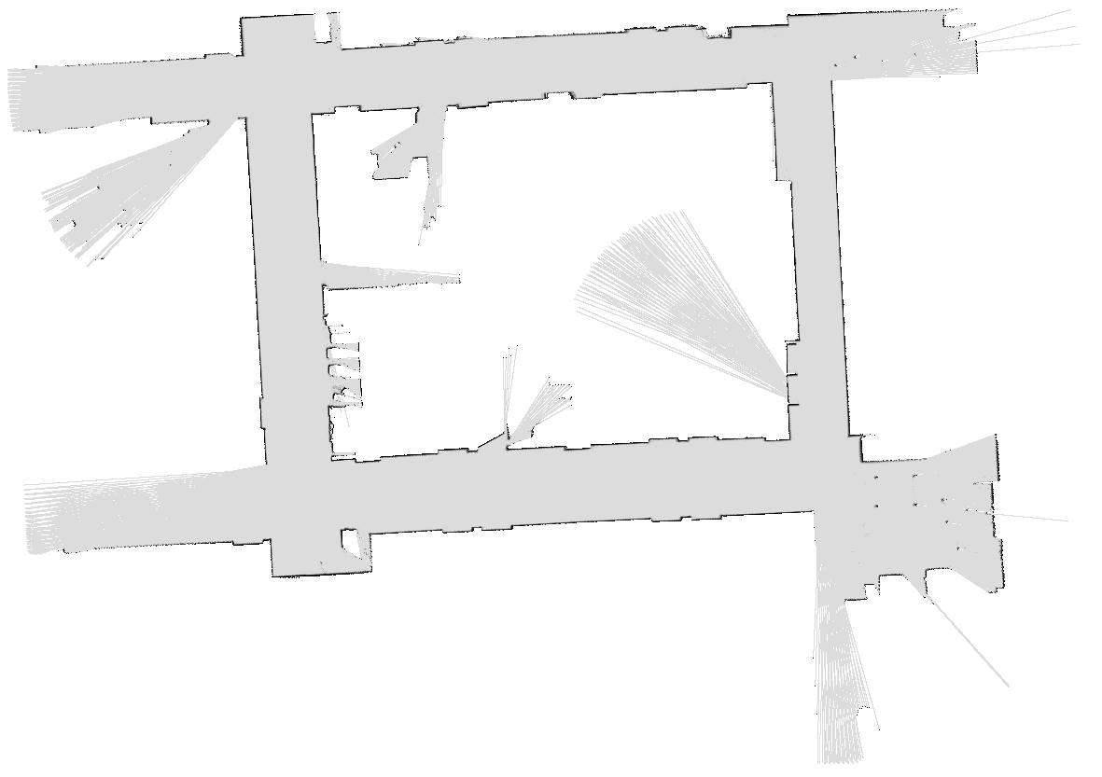
Robot Mapping
SLAM: Simultaneous Localization And Mapping
We do not know the map or our location
State consists of position AND map!
Main techniques: Kalman filtering (Gaussian HMMs) and particle methods
DP-SLAM, Ron Parr
[Demo: PARTICLES-SLAM-mapping1-new.avi]

Slide 52

Particle Filter SLAM – Video 1
[Sebastian Thrun, et al.]
[Demo: PARTICLES-SLAM-mapping1-new.avi]

Slide 53

Particle Filter SLAM – Video 2
[Dirk Haehnel, et al.]
[Demo: PARTICLES-SLAM-fastslam.avi]

